Slide 1
School of Geography and Geology
McMaster University
Applied Spatial Statistics
The Potential of Spatial Data
(and some caveats)

Slide 2
Spatial vs. Aspatial Data
How are spatial and aspatial data different?

Slide 3
Aspatial Data: Examples
Salary of professional baseball players
Concrete’s strength tests
Development of new drugs

Slide 4
Spatial Data: Examples
Location of bank branches
Groundwater pressure measurements
Population density

Slide 5
Spatial Data Analysis
Visualizing spatial data
Exploring spatial data
Modeling spatial data

Slide 6
Visualizing Spatial Data
Dot maps (Point patterns)
Contours (Spatially continuous data)
Choropleth maps (Area data)
Interactive mapping (GIS)
…

Slide 7
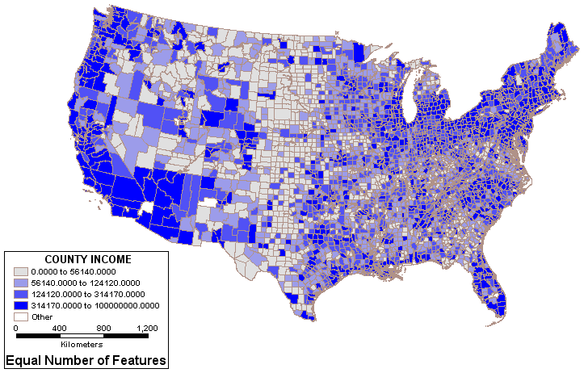
Visualizing Spatial Data:
Choropleth Map
County income in the US

Slide 8
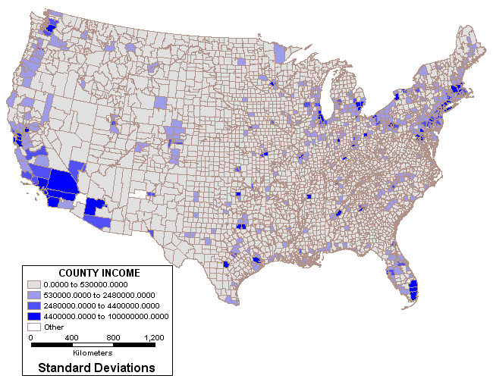
Visualizing Spatial Data:
Choropleth Map
County income in the US

Slide 9
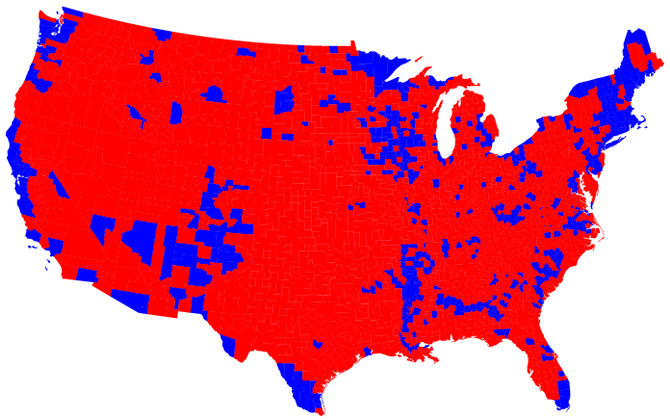
Visualizing Spatial Data:
Choropleth Map
US 2004 Election results
© 2004 M. T. Gastner, C. R. Shalizi, and M. E. J. Newman (http://www-personal.umich.edu/~mejn/election/)

Slide 10
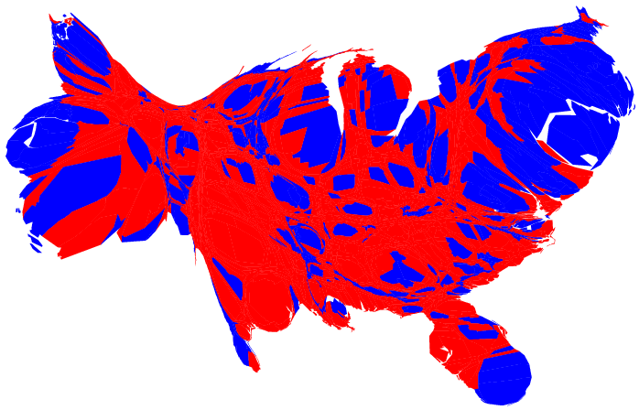
Visualizing Spatial Data:
Population weighted cartogram
US 2004 Election results
© 2004 M. T. Gastner, C. R. Shalizi, and M. E. J. Newman (http://www-personal.umich.edu/~mejn/election/)

Slide 11
Exploring Spatial Data
Good descriptions of the data
Few a priori assumptions
Fact finding, development of working hypotheses, etc.
Robust, Sufficient methods
Typically univariate or bivariate methods (involving one or two variables)

Slide 12
Exploring Spatial Data
What is a robust method?

Slide 13
Exploring Spatial Data
Robust method are resistant to atypical observations (outliers)

Slide 14
Exploring Spatial Data
Sufficiency criterion

Slide 15
Exploring Spatial Data
Sufficiency criterion

Slide 16
Exploring Spatial Data
A combination of conventional techniques + maps
Specialized techniques
  Statistics for detecting spatial patterns
  Statistics for describing spatial patterns

Slide 17
Modeling Spatial Data
Explanation
Relationships
Stronger assumptions
Testing of hypotheses
Robust, Sufficient methods
Typically multivariate (involving two or more variables)

Slide 18
Modeling Spatial Data
Specialized techniques
  Simulation
  Regression analysis

Slide 19
Modeling Spatial Data
Sufficiency criterion
Y
X

Slide 20
Modeling Spatial Data
Sufficiency criterion

Slide 21
Why are there spatial patterns?
Identical reaction to environmental factors

Slide 22
Why are there spatial patterns?
Identical reaction to environmental factors
  If we know all the factors, conventional analysis is sometimes sufficient
  Often we cannot observe all factors: specialized techniques are required

Slide 23
Why are there spatial patterns?
Spatial processes
  Diffusion
  Transfer and exchange
  Interaction
  Dispersal

Slide 24
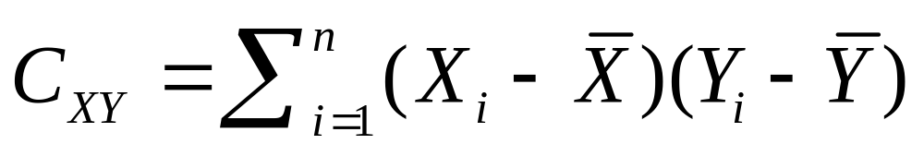
Why are there spatial patterns?
Covariance

Slide 25


Why are there spatial patterns?
Covariance

Slide 26
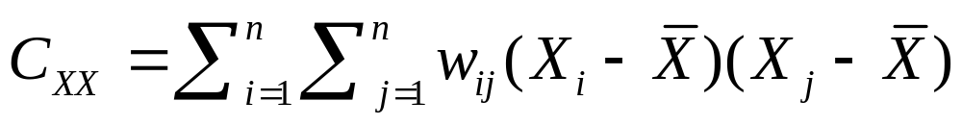
Why are there spatial patterns?
Autocovariance
Autocorrelation

Slide 27
Why are there spatial patterns?
Spatial correlation structure
First order effects
Mean=E[Y]
Second order effects
COV[Y_{i},Y_{j}]
Y
X

Slide 28
Next
Point pattern analysis I

Slide 29
Stationary Process
Spatial Data Types of Spatial Data Visualization/Exploration/Modeling Patterns

Slide 30
Non-Stationary Process
Spatial Data Types of Spatial Data Visualization/Exploration/Modeling Patterns

Slide 31
Isotropic Process
The covariance depends only on distance
X_{k}
X_{j}
X_{i}
COV[X_{i} , X_{j}]=COV[X_{i} , X_{j}]
Spatial Data Types of Spatial Data Visualization/Exploration/Modeling Patterns

